Slide 1
OOP with Python
By Dr Shantanu Pathak

Slide 2
OOP:Object Oriented Programming
Class
Bind data and method together
Object
Instance of class
Example: Student Class
Attributes: name, roll no, mod1_marks, mod2_marks
Functions: display(), calc_total_marks()

Slide 3
OOP : Object Oriented Programming
Encapsulation : Data and methods are put together using a class
Abstraction : give only important details to the user using class and methods
Inheritance : Existing code can be easily reused using inheritance from base class to derived class
Polymorphism : functions can behave differently for different types of inputs, this gives generalization

Slide 4
Python Specific OOP

Slide 5
Main Features of OOP in Python
Everything in Python is an object, so classes are also objects
Programmer can create a class and its instances in python
Python Supports Object Oriented Programming
allows re-use of code in class by using inheritance
Multiple inheritance is allowed
Classes are dynamic, means created at runtime and can be modified after they are created
Class is created as a variable in current namespace
Current namespace can be module namespace/ function namespace/ another class namespace

Slide 6
Main Features of OOP in Python
All members of class including variables ( data members) and methods are PUBLIC. (like C++)
In methods first argument represents the object calling the method
Built-in classes can be extended by inheritance
Built-in operators can be redefined using inheritance (overriding)

Slide 7
Limitations of OOP with Python
Limitations:
Data hiding is limited in python

Slide 8
keywords
Self keyword
Reference to current object calling the function
Used as first parameter in instance methods
Like ‘this’ keyword in java
‘self’ is a naming convention
Using other word for referencing to current object will make code less readable to other programmers
cls keyword
Refers to current class which is calling the function
Used for class methods

Slide 9
Attributes / Variables
Types:
1. Instance variables
Can be created ONLY by using self keyword inside instance method
Accessible ONLY to current object
Always has to access using ‘self’ keyword
2. Class Variables OR static variables
Can be created outside any method in class / inside a method using class name / cls
Can be created in any method
Accessible to all objects

Slide 10
Attributes / Variables.. (cont.)
Can access and modify all variables directly outside class also
This is allowed in python
So all variables are public!!
Class/static variable is accessed outside class using class name
Instance variable can be accessed outside class using object
Mutable variables as class variables are discouraged
because modification by one instance will have effect on other instance’s class variable!
If class variable name and instance variable are same then attribute lookup prioritizes instance variable

Slide 11
Attributes / Variables.. (cont.)
Every instance of class has attribute __class__ which gives class name of that instance
Ex. object.__class__
Add or delete attributes to a single object is possible
You can add instance variable to a single object
This is not present in JAVA / C++
Be careful
This makes Python memory efficient specially when having big hierarchy of class inheritance

Slide 12
Methods
Functions inside a class
Types:
Instance method
First parameter is self (current object reference)
Class method
First parameter is cls (calling class)
Decorator @classmethod
Static method
No self or cls parameters
Decorator @staticmethod
NOTE: Class method and static method are different in Python

Slide 13
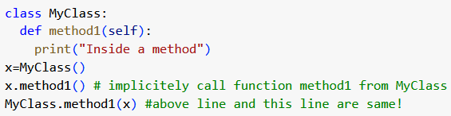
Methods … (cont.)
Instance Method
First argument should be ‘self’
Can access instance variables using self
Can read static / class variables using self
What happens when an instance method is called ?
Implicitly PVM calls the function using the class name
First argument is the object using which method is called
Ex.

Slide 14
Constructor in Python
Python creates an object using __new__() method of class and then the newly created object is initialized using __init__() method of a class

Slide 15
__init__() in Python
It is used to initialize the object
It is a special method in python (dunder method)
Two time underscore init two times underscore
First argument “self”
IT IS COMPULSORY parameter!
Can have any number of parameters
Self is compulsory at first place
CANNOT overload __init__
It is always a instance method

Slide 16
How Object is created in Python?
Obj_name = MyClass()
This calls the __new__(cls) method for MyClass.
In __new__(cls) memory is allocated to the object
Then __init__() is called with newly created object
Example: How to create class which has MAX 3 objects in memory ?
Override __new__(cls) method and using static variable _count to count the objects!!

Slide 17
Data Hiding in Python
Gives syntax to hide the variable name
Thumb rule -> use two underscore “__” before name of the variable
Cannot be directly accessed outside the class
What happens inside? 🡪 name mangling is done!
When any variable is created with two underscores “__” before it , then python renames the variable as
_ClassName__VarName
Because name of variable is changed now it can’t be accessed outside
Quote From documentation of python :
“In fact, nothing in Python makes it possible to enforce data hiding it is all based upon convention.”
Ref : https://docs.python.org/3/tutorial/classes.html

Slide 18
Common Attributes of every class
__dict__: Dictionary containing the class's name-space.
__doc__: Class documentation string or None( if undefined)
__name__: Class name.
__module__: Module name in which the class is defined.
__bases__: tuple containing the base classes, in the order of their occurrence in the base class list.

Slide 19
Decorators in Python
decorators wrap a function, modifying its behavior.
Uses pie syntax (@decoratorname)
Decorator is also a function in python
Used for ease of syntax

Slide 20
Additional OOP Topics in Python

Slide 21
Inheritance
All types of Inheritance are allowed in Python
Multi level
Multiple
Hybrid

Slide 22
Inheritance
What Child class can inherit?
All attributes and methods (functions)
Instance variables
Instance methods
Exercise : check class variable , class method and static method
Python allows Method Overriding
Method can have same name in parent and child class but can have different implementation
All methods in a class are virtual by default
Means any method in base class can be overridden by its derived class

Slide 23
How to call Parent Constructor/method?
Parents Default constructor is called automatically
For Parameterized Constructor/init:
super().__init__() : Used to call if single parent
<Parent Class>.__init__() : used when multiple inheritance is present
NOTE: super() is useful for accessing inherited methods that have been overridden in a class.
ex. super().method1()

Slide 24
Private / Protected Variables ;)
Only convention / Understanding
If variable name has a single “_” then it should be considered as private and should not be modified by child class
Name Mangling:
Variable with two “__” is changed its name

Slide 25
Method OVER-RIDING
There are two options in Python
1. Replace the method of Base class
2. Extend the method in Base class
This adds functionality to Base Class Function
So, it first calls the Base Class method
Then adds extra operations

Slide 26
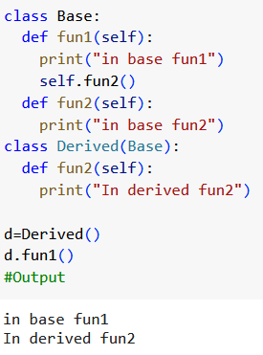
Method OVER-RIDING … (cont.)
Replace method in base class

Slide 27
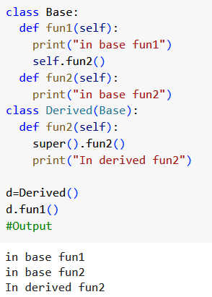
Method OVER-RIDING … (cont.)
Extend method in base class
Using super()

Slide 28
__repr__() vs __str__()
str : is used to give user friendly and readable object representation
If str function is not defined for an object then its repr method is called
repr : is used to give debugging friendly messages to programmer

Slide 29
Operator Over-riding/ Overloading
Take the relevant method related to the operator
Give relevant number of parameters
Self , other
Perform the operation
Return new object of the same class

Slide 30
Exercise
Create simple Multi level inheritance
Base Class Employee
Child Class Manager

Slide 31
Abstract Classes and Methods
Any Class which inherits ABC class
It cannot be instantiated
Can have Abstract method
Abstract Method
Created using @abstract method decorator
May not have any implementation
Can only be written using “…” inside it
NOTE: For ABC and @abstractmethod package ‘abc’ needs to be imported

Slide 32
Casting In Python
Python doesn’t support casting!
NO upcasting or downcasting!

